Slide 1
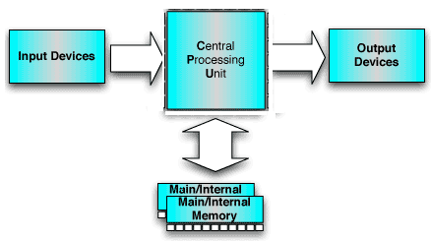
top level view of computer
Block diagram of computer

Slide 2
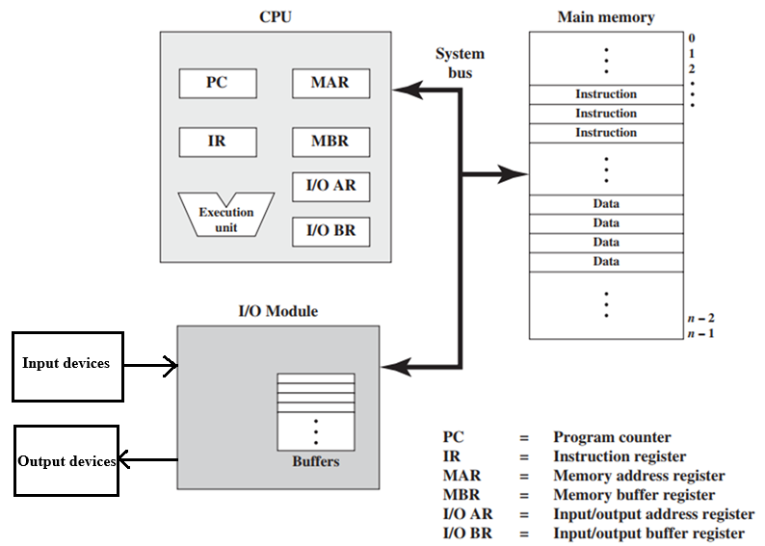
Computer Components: Top-Level View

Slide 3
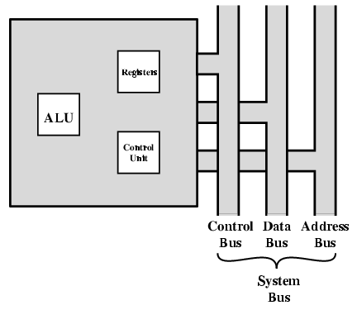
CPU
Block diagram

Slide 4
Main components in CPU
ALU
Registers
Control unit
Function of CPU
Fetch instructions
Interpret/decode instructions
Fetch data /operand
Process data
Write Processed data

Slide 5
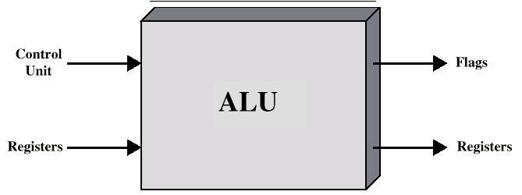
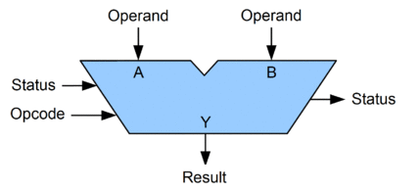
ALU
An arithmetic logic unit (ALU) is a combinational digital electronic circuit that performs arithmetic and bitwise logical operations on integer binary numbers.
Other types floating-point unit (FPU), which operates on floating point numbers and graphics processing units(GPUs).
A single CPU, FPU or GPU may contain multiple ALUs.

Slide 6
Registers
-Small set of high speed storage( memory) locations inside the CPU
Used for Temporary storage for data and control information ( Analogy : grocery in house & grocery shop)
Two types of registers
User-visible
These Can be used in assembly-level instructions and are thus “visible” to the user
– Control and status registers
Used to control the operation of the CPU
Most are not visible to the user

Slide 7
User Visible Registers
General purpose
Can be assigned a variety of functions
Ideally, they are for the operations within the instructions
Data
These registers only hold data
Address
These registers only hold address information
Examples: address registers, segment registers, stack pointers, index registers
Condition codes ( flag register, Status register)
Visible to the user but values set by the CPU as the result of performing operations
Example code bits: zero, positive, overflow
Bit values are used as the basis for conditional jump instructions

Slide 8
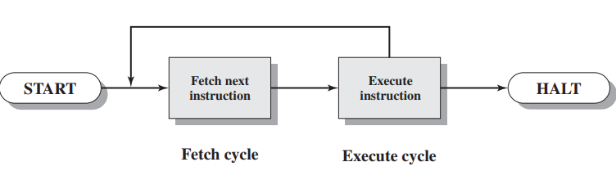
Simplified CPU operation

Slide 9
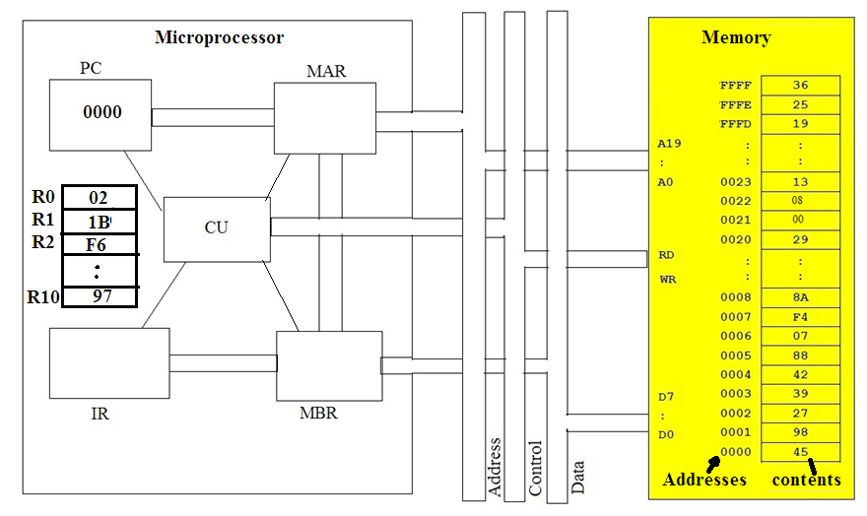

Animation of how processor executes instructions
When CPU is turned ON , it starts fetching instruction from address 0000 ,
So it loads PC with 0000

Slide 10
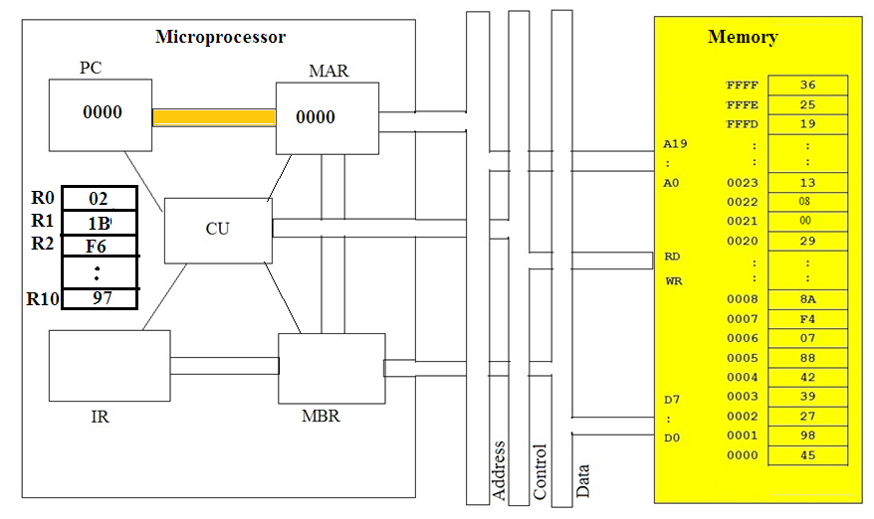
Contents of PC Is transferred to MAR

Slide 11
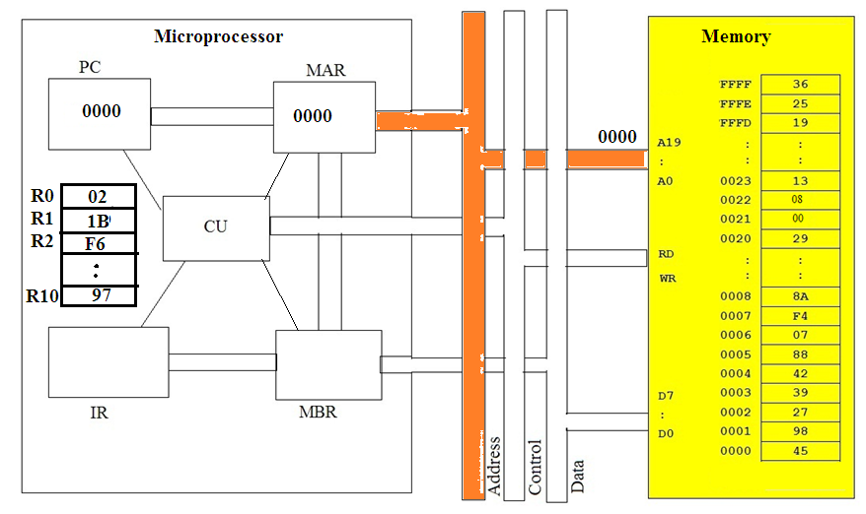
Contents of MAR are sent on address bus

Slide 12
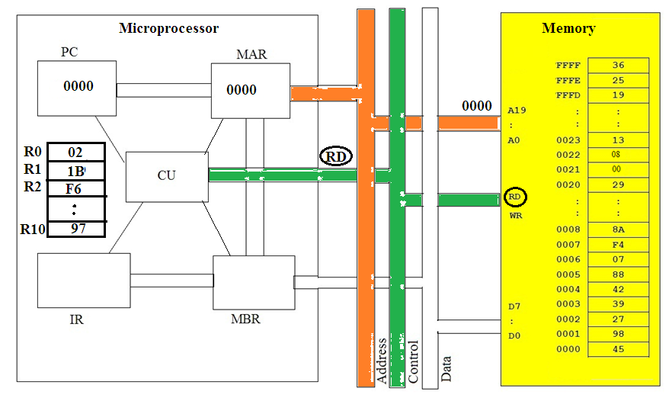
CU then sends read ( RD) signal on control bus

Slide 13
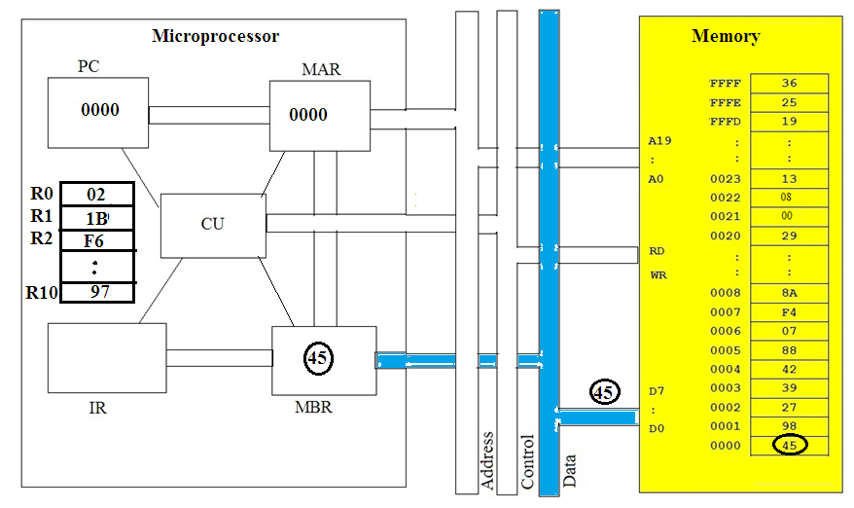
Memory sends contents of address 0000 on data bus which is laded in MBR

Slide 14
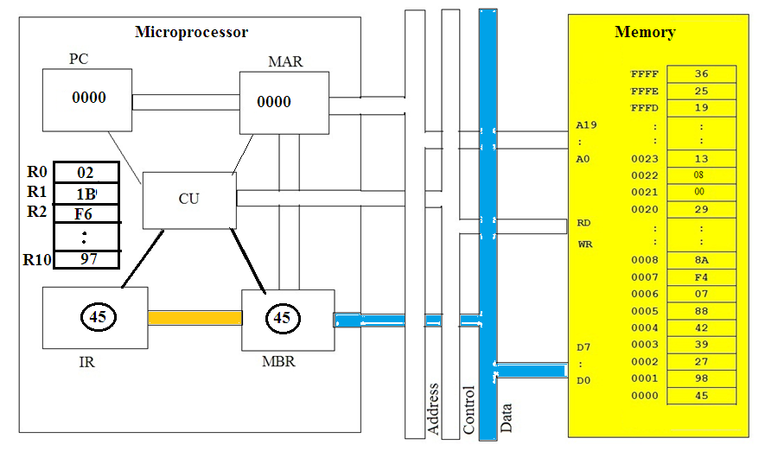
CU transfers MBR contents to instruction register IR , since it is an instruction

Slide 15
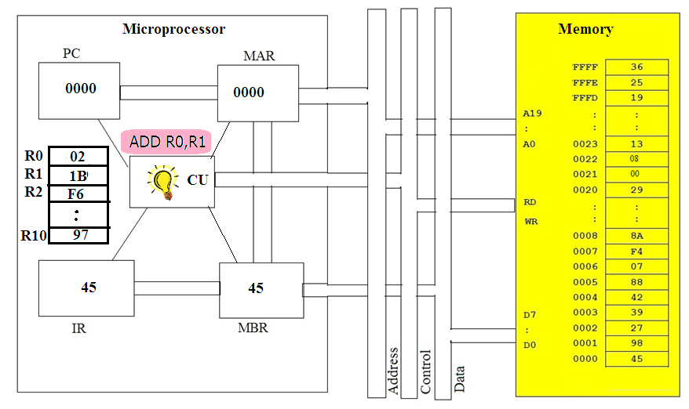
CU decodes instruction , it finds that R1 is to be added in R0 and
result to be stored in R0

Slide 16
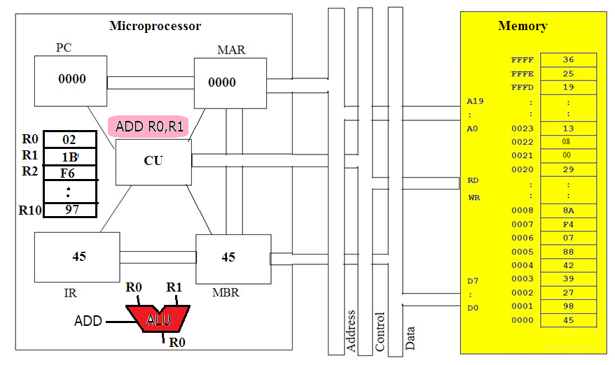
CU gives R0 and R1 contents to ALU and gives add signal to ALU

Slide 17
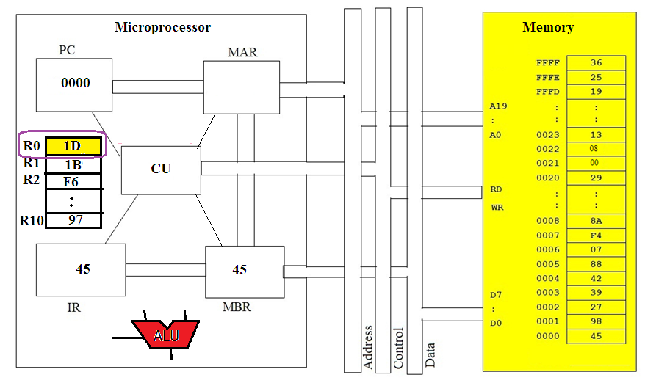
The result of addition is transferred by CU in R0

Slide 18
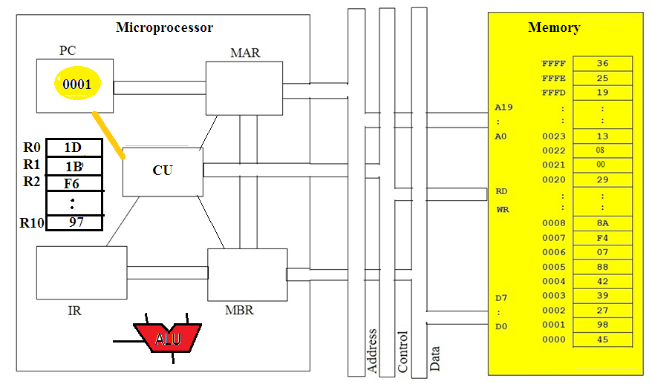
CU then increments PC by 1 to fetch next instruction from 0001

Slide 19
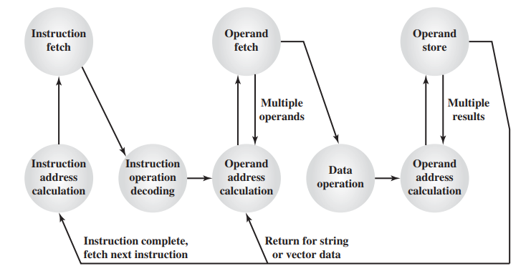
Instruction cycle detailed

Slide 20
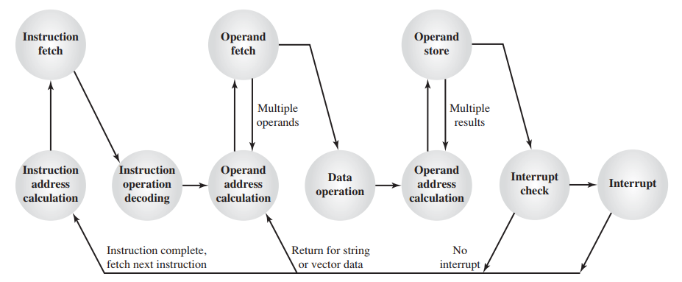
Instruction cycle with interrupt handling
all computers provide a mechanism by which other modules (I/O, memory) may interrupt the normal processing of instructions by the processor.
To take care of some other functions ( such as key pressed on keyboard , some error occurred etc)
Interrupt is checked after each instruction is executed.

Slide 21
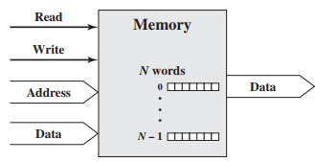
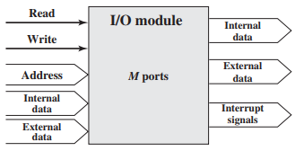
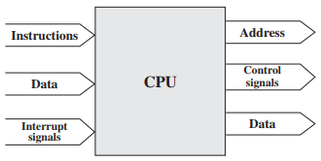
INTERCONNECTION STRUCTURES
A computer consists of a set of components or modules of three basic types (processor, memory, I/O) that communicate with each other.
So, a computer is a network of basic modules. Thus, there must be paths for connecting the modules. The collection of paths connecting the various modules is called the interconnection structure.

Slide 22
BUS INTERCONNECTION A bus is a communication pathway connecting two or more devices.
it is a shared transmission medium. Multiple devices connect to the bus, and a signal transmitted by any one device is available for reception by all other devices attached to the bus.
If two devices transmit during the same time period, their signals will overlap and become garbled. Thus, only one device at a time can successfully transmit.
Typically, a bus consists of multiple communication pathways, or lines. Each line is capable of transmitting signals representing binary 1 and binary 0.. Taken together, several lines of a bus can be used to transmit binary digits simultaneously (in parallel). For example, an 8-bit unit of data can be transmitted over eight bus lines

Slide 23
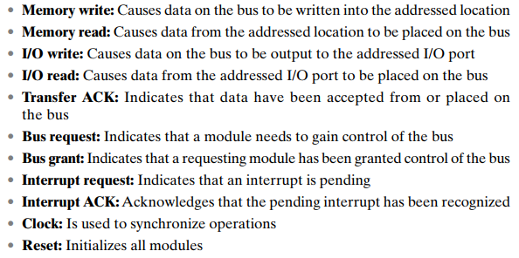
Address lines:
Only CPU sends address of memory location or I/O device from where it wants to read or to write data.
Control lines :
signals sent by CPU or I/O devices to inform what operation is being carried out

Slide 24
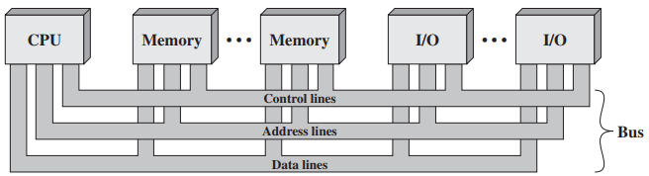
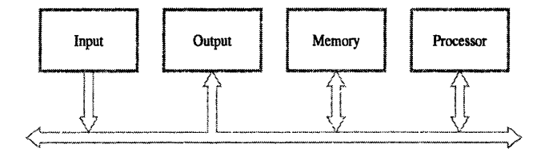
Single bus structure
Simple but slow

Slide 25
Multiple-Bus Hierarchies If a great number of devices are connected to the bus, performance will suffer.There are two main causes: 1. In general, the more devices attached to the bus, the greater the bus length and hence the greater the propagation delay. 2. The bus may become a bottleneck as the aggregate data transfer demand approaches the capacity of the bus.
Solution : most computer systems use multiple buses, generally laid out in a hierarchy.

Slide 26
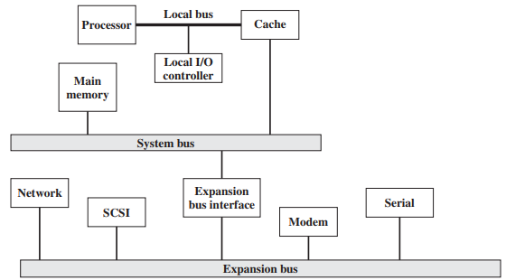
Traditional bus architecture
This architecture is efficient but begins to break down as higher and higher performance I/O devices are connected . eg graphics card

Slide 27
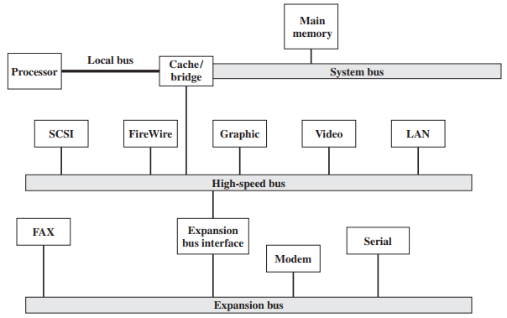
Solution:
a high speed bus is added in the system, requiring only a bridge between the processor’s bus and the high-speed bus.
The cache controller is integrated into a bridge, or buffering device, that connects to the high-speed bus

Slide 28
advantage of this arrangement is
the high-speed bus brings high demand devices into closely interacting with the processor and at the same time is independent of the processor. Thus, differences in processor and high-speed bus speeds and other signals are tolerated.
Changes in processor architecture do not affect the high-speed bus, and vice versa.

Slide 29
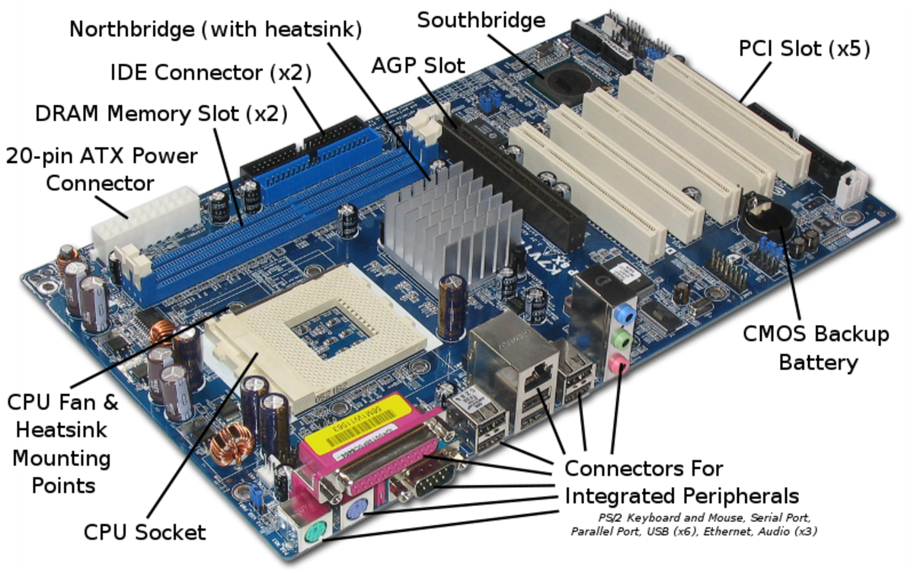

Slide 30
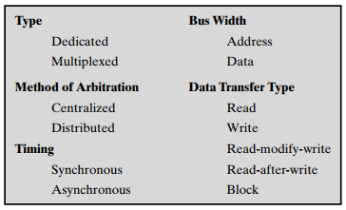
Elements of Bus Design

Slide 31
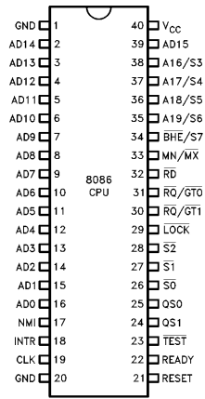
Bus type:
Dedicated and multiplexed.
A dedicated bus line is permanently assigned either to one function.
Multiplexed bus can do different function at different times
8086 uses multiplexed address & data bus

Slide 32
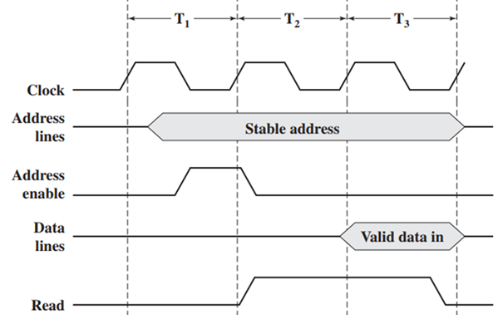
Synchronized
All devices are Synchronized With each other using clock signal
Synchronous timing is simpler to implement and test . So used in almost all computers
Eg memory read operation by CPU

Slide 33
Address bus size
determines number of memory locations that can be accessed i.e. amount of memory that can be connected to CPU
N address lines can access memory up to 2 ^{N}
16 bit address bus can access 2 ¹⁶ = 65535 = 64k memory
Data bus size
Determines the size of data that can be transferred at a time
8 bit data bus can transfer 8 bits at a time

